Slide 1
Electronic Voting for Town Meeting
Article 10 October 22, 2022
Presented by:
Electronic Voting Study Committee

Slide 2
Electronic Voting Study Committee
Created by the Spring 2022 Town Meeting
Chartered to:
explore the option of implementing electronic voting at Town Meeting
provide a report to the 2022 Fall Town Meeting addressing all issues associated with such a change including but not limited to cost, bylaws and administrative procedures
Members appointed by the Moderator
Jack Petropoulos (Chair)
Carolyn Perkins (Vice-Chair) Robert Anctil
Michael Manugian (Clerk) Michael Bouchard (Town Clerk Rep)

Slide 3
What is Electronic Voting (at Town Meeting)?
Alternative method of voting at Town Meeting
Voters would use “handsets” to register a vote
Votes are “received” by a dedicated stand-alone computer
Replaces “voter card”, voice vote and hand count methods
Would be available ONLY for Town Meeting and only in person
This is not for elections or remote voting for town meeting
Used by many types of organizations
70 Massachusetts Towns (for open and representative town meetings)
US House of Representatives, NH House of Representatives
Delegate voting, audience response, shareholder voting, education….

Slide 4
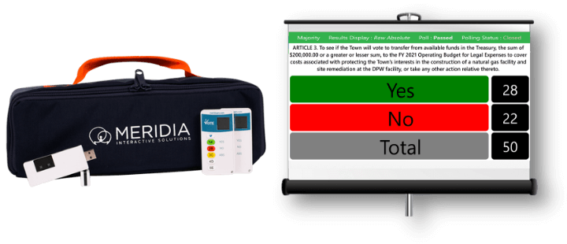
Why Electronic Voting?
Anonymous Votes
Eliminates social pressures and “herd voting”
A truer representation of votes
Accurate
Produces an exact vote count
No changes required to bylaws or Charter
Secure
Radio frequency band-shifting
No Internet, Wi-Fi or Bluetooth connections

Slide 5
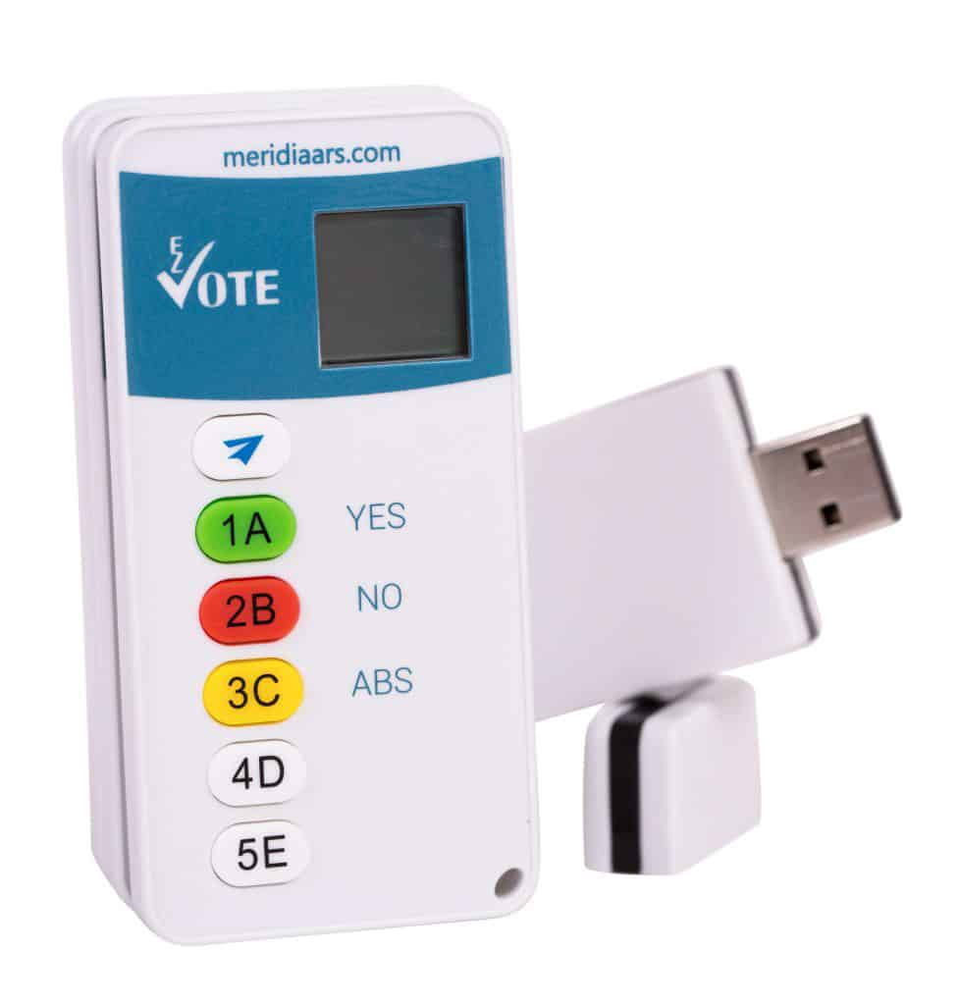
Electronic Voting – How it Works
Electronic Voting Demonstration

Slide 6
Electronic Voting – Costs
$25,000 one time cost to include:
600 attendee hand held devices
Base system receiver and backup
Standalone dedicated laptops for system use
10 year (or more) expected life
Minimal / manageable ongoing “soft costs”
E.g. : testing, setup, cleaning, batteries, etc.
Can be expanded beyond 600 hand held devices
Minimal incremental costs

Slide 7
Electronic Voting – What would be different?
Method of voting
Recommended Procedures (examples):
Handset issuance and return
“Voting Window”
Recommended Policies (examples):
System testing
Electronic Voting “Assistants”
What’s Not Different: Town Meeting debate

Slide 8
Electronic Voting Study Committee Recommendations
Adopt electronic voting
Perform public outreach and education
Develop specific policies and procedures, promoting
Anonymity
Security
System verification

Slide 9
Questions? Comments?
Thank you!

